Slide 1
RESEARCH THESIS
OOP HELPER: A GAMIFIED MOBILE APPLICATION FOR OBJECT-ORIENTED PROGRAMMING CONCEPTS
STUDENT NAME
AKAWA JOHANNES SHEEPO
218200218
SUPERVISOR NAME
Mr. T. HAIDUWA

Slide 2
Table of contents
1.Introduction
2.Problem Statement
3.Objectives
4.Significance
5.Motivation
6.Literature Review
7.Methodology
8.Results
9.Discussion
10.Conclusion
11.References

Slide 3
1. Introduction
Object-Oriented Programming (OOP) is one of the most critical module required by all Computer Science or Information Technology (IT) students as it is widely used and very popular in the software development industry.
Lecturing OOP is not as easy as expected. Lecturing unmotivated students is a predicament faced by lecturers every single In recent years, the passing rate of OOP module at the University of Namibia (UNAM) has been around 30 to 40%.
To increase the interest of students in learning, gamification approach should be used, which delivers learning contents in an easier, interesting, competitive and entertaining way.

Slide 4
2. Statement of the problem
The current use of student-centred approach proves to be insufficient for the inexperienced students doing Object oriented programming. According to Iyawa et al. (2019) in a study to design, develop and evaluate a gamified mobile application to support the learning of basic and advanced computational concepts in the Department of Computer Science at UNAM, identified that OOP is one of most challenging module in the UNAM school of Computing. In 2019, eighty-three (83) students registered for OOP 2. In a group of these students, 25% of the student did not qualify to write the examination. This indicate that most students struggle with mastering the OOP basic concepts (classes, objects, attributes, methods, inheritance, polymorphism, and encapsulation). Despite the use of interactive e-learning platform (Moodle), the university need to explore more on options provided by gamification. The Moodle learning platform (eLearning) needs to be aided with the mobile application to facilitate the learning process in the OOP modules.

Slide 5
3. Objectives of the study
The primary objective of this study was to develop a gamified mobile application to add to the existing eLearning platform in order to provide an motivating way to deliver OOP contents.

Slide 6
4. Significance of the study
There have not been any gamified mobile application in the context of OOP at the University Of Namibia.
Therefore, this study will genuinely contribute to the body of literature on gamification for educational purposes in the context of Object Oriented Programming in Namibia.
In addition, it aimed to promote quality delivery of education in Namibia through game-based learning. A necessity presented in the Namibia’s fifth (5th) National Development Plan (NDP5) that is to “improve quality of teaching and learning in university and strengthen research capacity at higher education institutions” (National Planning Commission , 2017).

Slide 7
5. Motivation
Statistics for 2019 and a study by Iyawa (2019) has shown that OOP1 and OOP2 is a challenging module to students.
For this reason, it has raised a desire for the researcher to help student who facing challenges in the OOP module by creating an application to motivate them.

Slide 8
6. Literature Review
6.2 Overview of Gamification and Object-oriented Programming
Apostol et al. (2013) identify eight elements of games that are used for the gamification of learning, such as: rules, goals and outcome, feedback or rewards, problem solving, story, player(s), safe environment, sen­se of mastery.
Object-oriented programming is a programming paradigm or methodology that creates programs using classes and objects.

Slide 9
6.3 Review of related work
6.4.1 Usage of Gamified mobile application in tertiary education.
6.4.1.1 CS challenger
CS Challenger is a mobile application that incorporates gaming techniques for motivating students so that they can entertainingly tackle challenging modules in the Department of Computer Science at UNAM (Iyawa et al., 2019).
6.4.1.2 Alice 3D
Alice is a three-dimensional (3D) animation programme, which provides highly interactive and visualised environment for the players to construct a virtual world by inserting different levels of Java coding.
6.4.2 Impacts of Gamified mobile applications to student engagement and motivation and academic performance.
Wong and Maizatul(2013) in the investigation on gamified mobile application as learning and teaching tool for object oriented programming in higher education institution, summarised that “ most of the students agreed that the gamified mobile application able to meet the learning and teaching objective” p.223.

Slide 10
6.5 System Design
6.5.1. Mobile App Overview (Technologies)
The following components were used in designing the application. Microsoft Visual studio 2019 - this was used for the core development of the application in C#. The Unity game engine version 2020.3.1f1 (64-bit) for the creation of the User Interfaces (UI) using XML and C#.
6.5.2. Software Development Life Cycle (SDLC)
The Mobile App was developed using the Waterfall Model – SDLC. This model is also known as sequential linear model because it follows a top down approach. This model was used because the waterfall is a plan-driven process. , all process activities are planned and scheduled before starting the software development. This means the researcher did the development in phases, and only when the phase was done, then researcher move to the next phase.

Slide 11
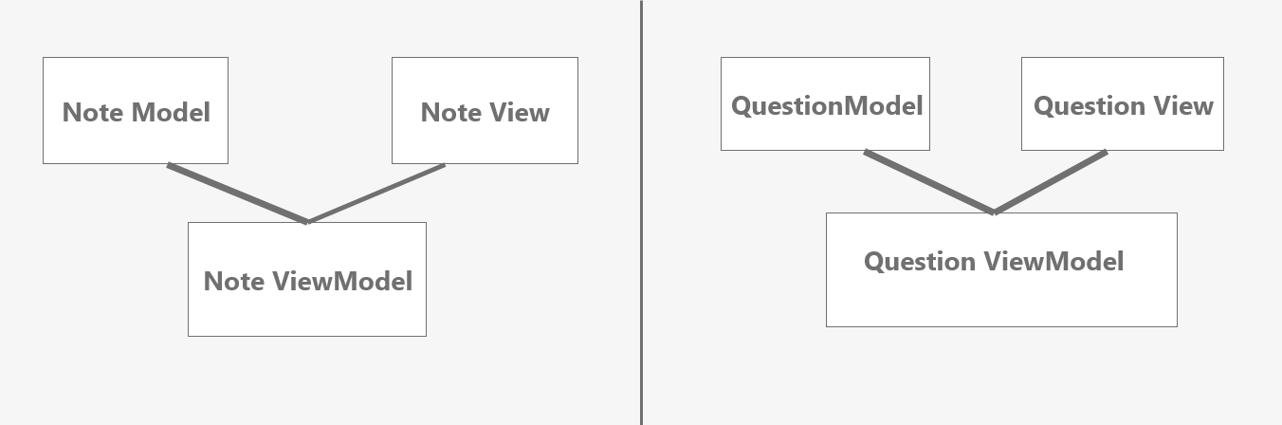
6.5.2.2 System Architecture
The application is designed using the Model-View-ViewModel (MVVM).

Slide 12
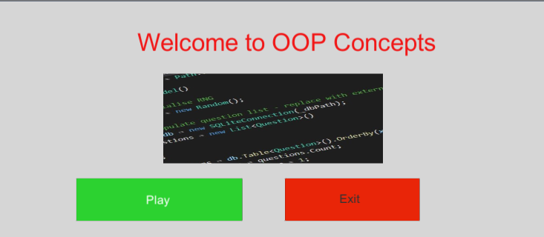
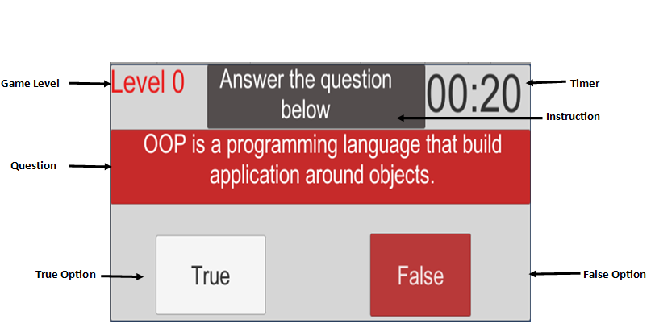
6.5.2.4 User Interfaces

Slide 13
7. Research Methods
7.1 Research Design
The study employed mixed research methods.
Mixed methods involves combining or integration of qualitative and quantitative research and data in a research study.
7.2 Population
The target population of the study comprised of all the students doing OOP 1 and OOP2 module at UNAM Main Campus.
7.3 Sample
Probability sampling techniques was used to select the sample from the targeted population. A simple random sampling was used.

Slide 14
Research Methods (Continued)
7.4 Research Instruments
The instrument that was used to collect data is the online questionnaires..
7.5 Procedure
Google forms was used to create the questionnaire. The link to the questionnaire was shared to the participants through e-mails or WhatsApp contact details.
7.6 Data analysis
The researcher used a descriptive statistics and thematic text analysis of data.
7.8 Research Ethics
The researcher ensured that confidentiality was observed in order to protect the participants of the research. The researcher did not disclose the identities of the participants. Finally, the researcher ensured that the all the data collected was used solely for the purpose of the study.

Slide 15
8 Results and Discussions
8.1 Demographic Information
This study reached data saturation with 28 participants. The participants of this study were asked questions to identify their gender and current year of studies level.
No Of Participants | Gender |  | Current Level Of Studies
28 | Male | Female | 1st year | 2nd year | 3rd year | 4th year
 | 18 | 10 | 1 | 15 | 9 | 3

Slide 16
8.2 Results
8.2.1 Have you ever experienced any difficulty in learning Object Oriented Programming (OOP) Concepts
A total number of 22 students that represent 78.6% of the sample indicated they experienced difficulties in OOP concepts and only 6 students which constitute 21.4% of the sample indicates that they had no problem in learning OOP Concepts .
8.2.2 Are you satisfied with student-centered approach way of learning offered by the university
The results showed that students are not satisfied with the student-centered approach way of learning offered by the university. Only 35% of the sample population are pleased with the approach , while 65% indicated their dissatisfaction
8.2.3 Do you prefer a competitive and entertaining form of learning OOP concepts?
Only three (3) students from the sample indicated that they do not have a preference in an entertaining and competitive form of learning.
8.2.4 You currently want an introduction of a mobile application to aid the UNAM eLearning platform
The results indicates that 53.6% of the sample indicates that the strongly agree with the introduction of the mobile application to the university. They are supported by 28,6% of the population that also agree with that statement. To add, 10.7% are yet undecided whether to agree or disagree with the statement. Only two students who strongly disagree.

Slide 17
9. Discussion
9.1 Students’ Viewpoints on Gamified OOP concepts
The helper is much easier since you can use it at any time on your own time unlike a lecturer with fixed time period and who is only available at some points in time.
From the statement above it is evident that the OOP helper is helpful in teaching OOP concepts due to many advantages such as, it is available at any time, student can learn at own pace or time and students can learn in a motivated way
9.2 Student Gaming Experience
-I was able to learn fast as I did not feel intimidated by the lecturer’s presence and of my fellow students
The researcher agrees with student as this study identified that the OOP helper increased the student freedom to learn without any fear or intimidation.

Slide 18
10. Conclusion
10.1 Conclusion
The research offered a game-based learning game, which covers the OOP concepts.
The objective of the study was to develop a gamified mobile application to improve students’ engagement in the OOP module and to add a mobile application to an existing eLearning platform in order to provide an interactive way to deliver OOP contents.
Henceforth, the study designed the OOP Helper application in order to meet the objective.
10.2 Recommendation
The study recommends that future researchers need to consider in-depth qualitative studies to assess the effectiveness of gamification in tertiary education in Namibia and Africa at large.
Furthermore, this study calls for more research to be done regarding Gamification, in the Namibian context as literature is very limited.
10.3 Future work
This study was only limited to designing an Application for OOP concepts that runs on the Android operating system, therefore the future works includes the development of the iOS-based application.

Slide 19
References
Durin, F., Lee R., Bade, A., On, C. K. and Hamzah, N. Impact of Implementing Game Elements in Gamifying Educational Environment : A Study, in J. Phys.: Conf. Ser. 1358 012064, pp. 1–7.
Faiella F., Ricciardi M. (2015), Gamification and learning: a review of issues and research, Journal of e-Learning and Knowledge Society, v.11, n.3, 13-21. ISSN: 1826-6223, e-ISSN: 1971-8829
Iyawa, G. E., Masikara, W., Osakwe, J. O., & Oduor, C. O. (2019, May). CS Challenger: Gamifying the Learning of Computer Science Concepts through a Mobile Application platform. 2019 IST-Africa Week Conference (IST-Africa). https://doi.org/10.23919/istafrica.2019.8764865
National Planning Commission. (2017, May). Namibia’s 5th National Development Plan (Ndp5) (ISBN: 978–99945-0-096-3). Retrieved from https://www.npc.gov.na/?wpfb_dl=294
Wong, Y. S., Maizatul, H. M. Y. (2013). Computer Game As Learning and Teaching Tool For Object Oriented Programming in Higher Education Institution. Procedia - Social and Behavioral Sciences 123 pp.215 – 224.

